Slide 1
METU RUZGEM SETUP Measurements Analaysis
FFT analysis
by S.Ozkucuk

Slide 2
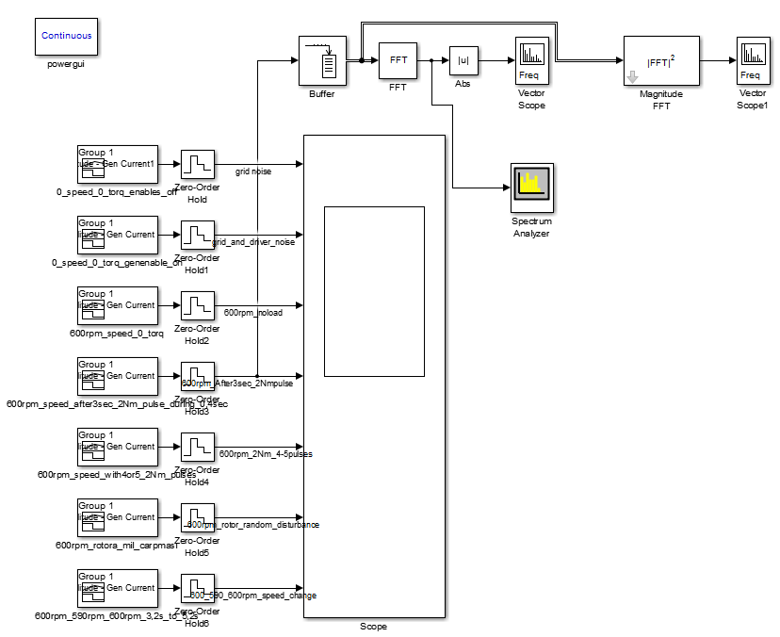
Simulink

Slide 3
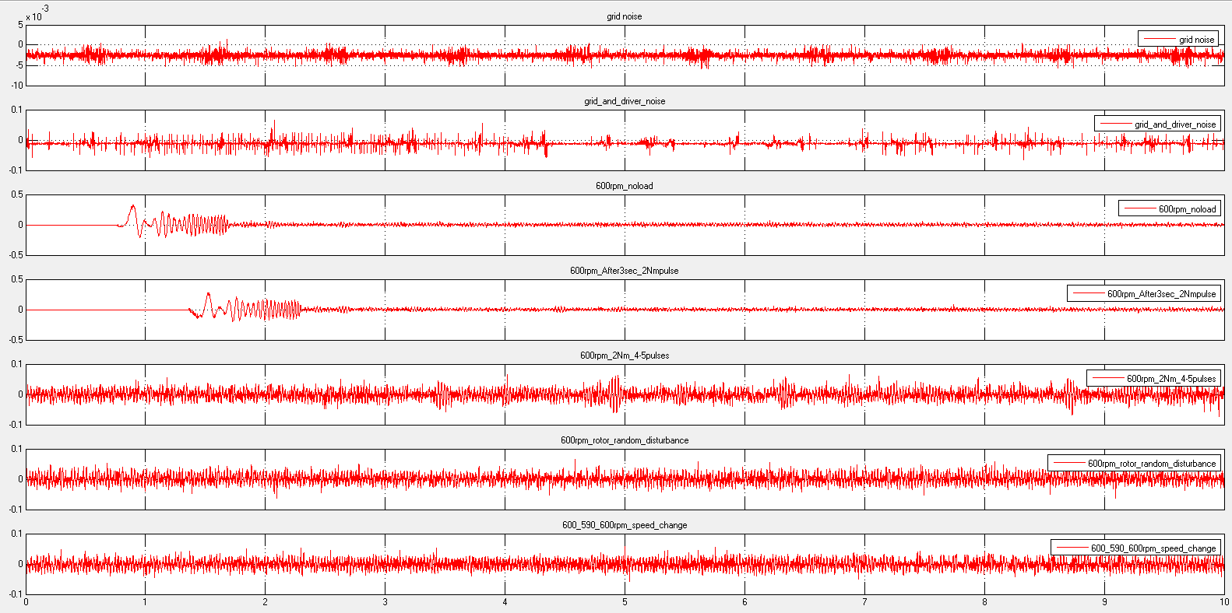
Time domain

Slide 4
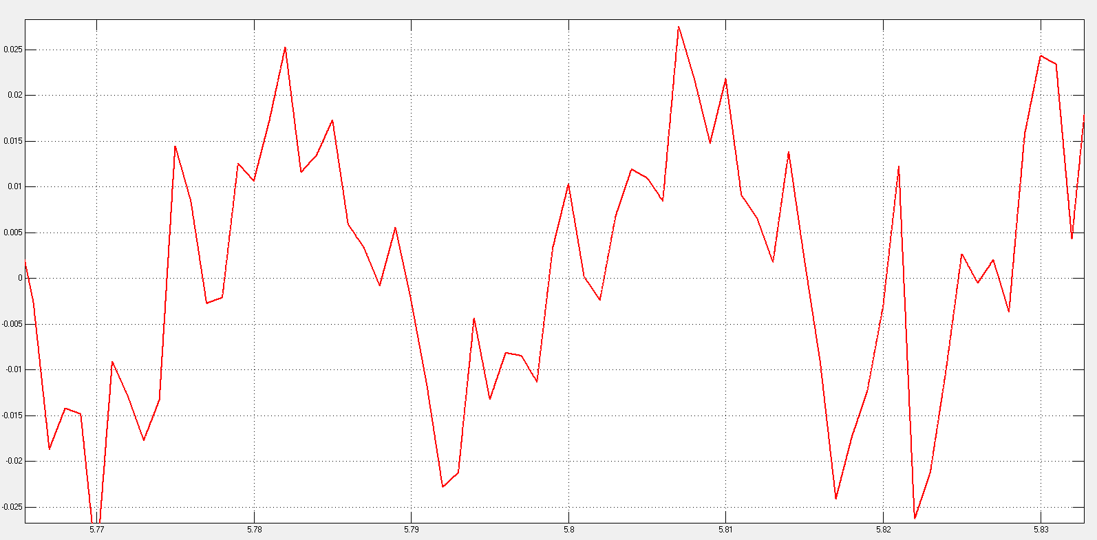
600rpm no load phase current

Slide 5
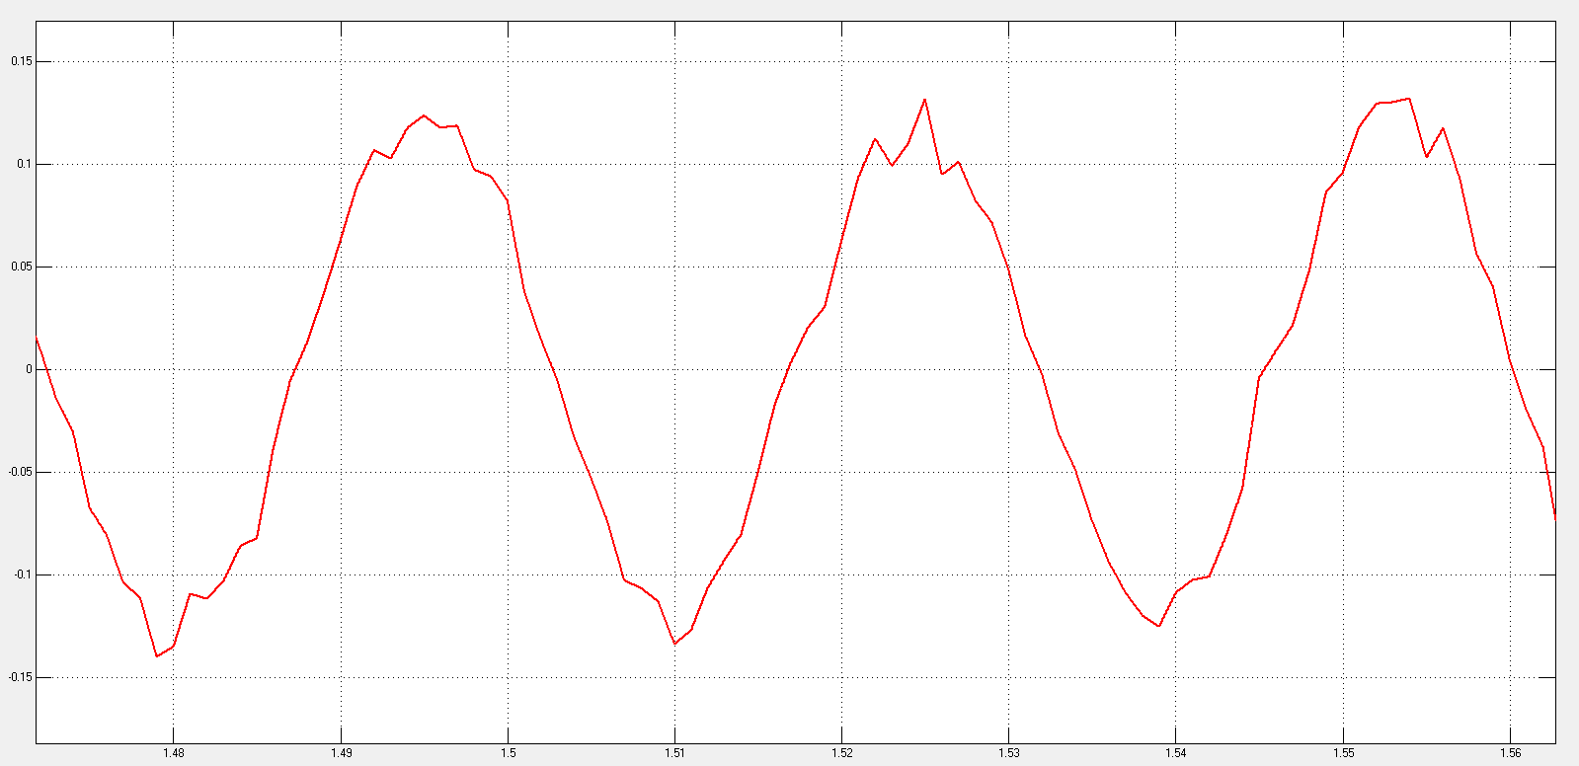
600rpm starting full load

Slide 6
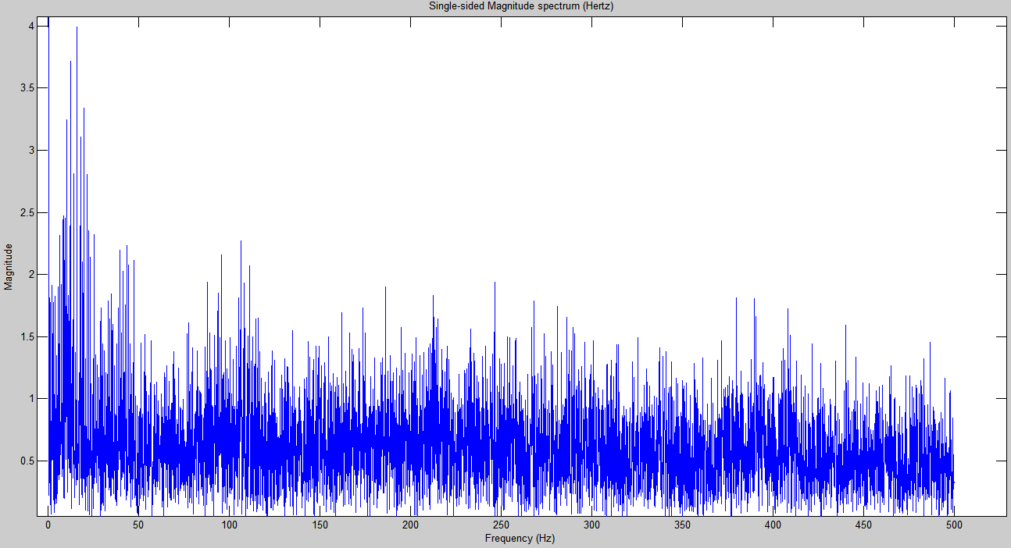
Grid + driver noise zoom 0-500Hz

Slide 7
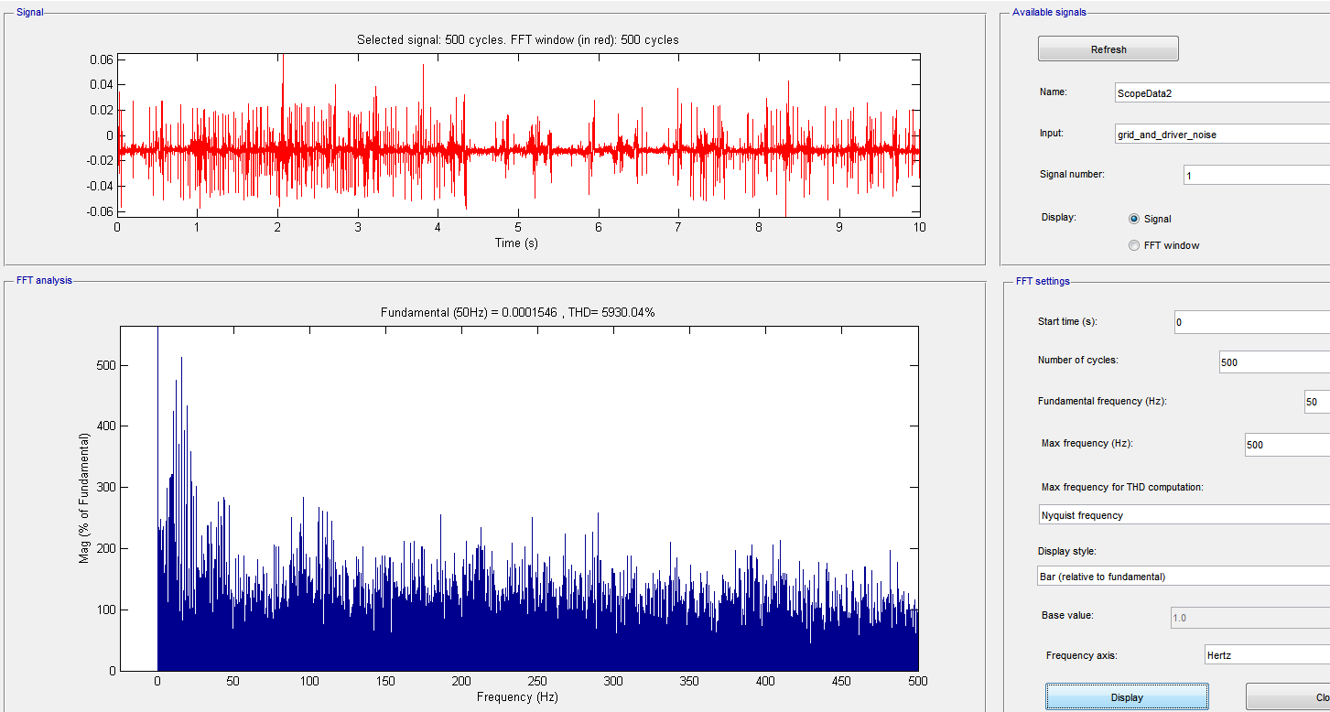
Grid + Driver noise

Slide 8
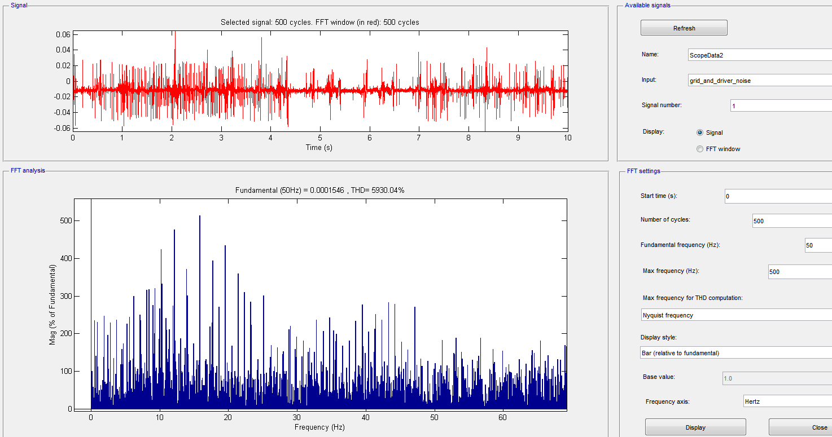
Grid + Driver noise

Slide 9
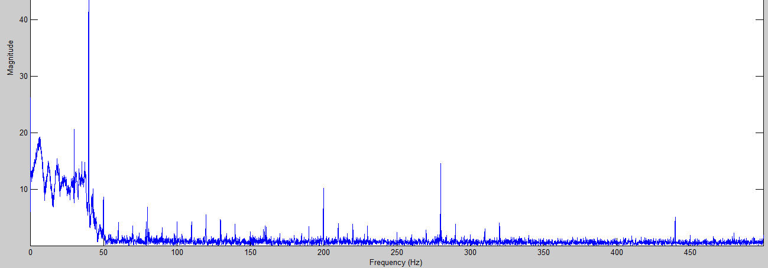
600rpm no load with starting currents

Slide 10
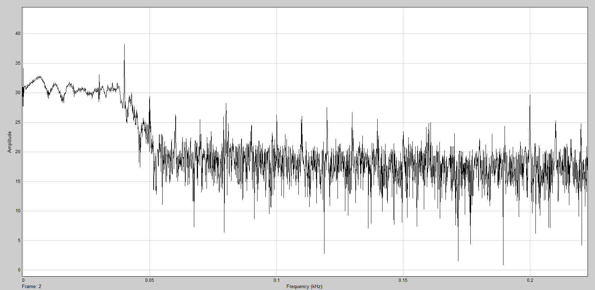
600rpm noload – 8pole PMSG-40Hz

Slide 11
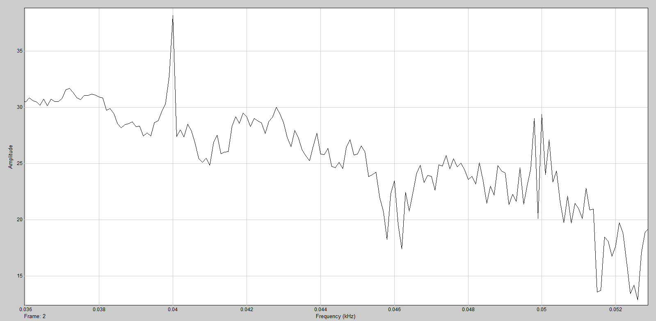
600rpm noload – 8pole PMSG-40Hz
fundamental
Grid

Slide 12
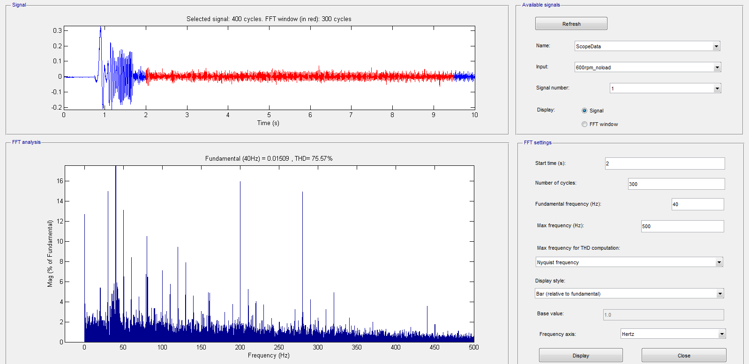
600rpm no load

Slide 13
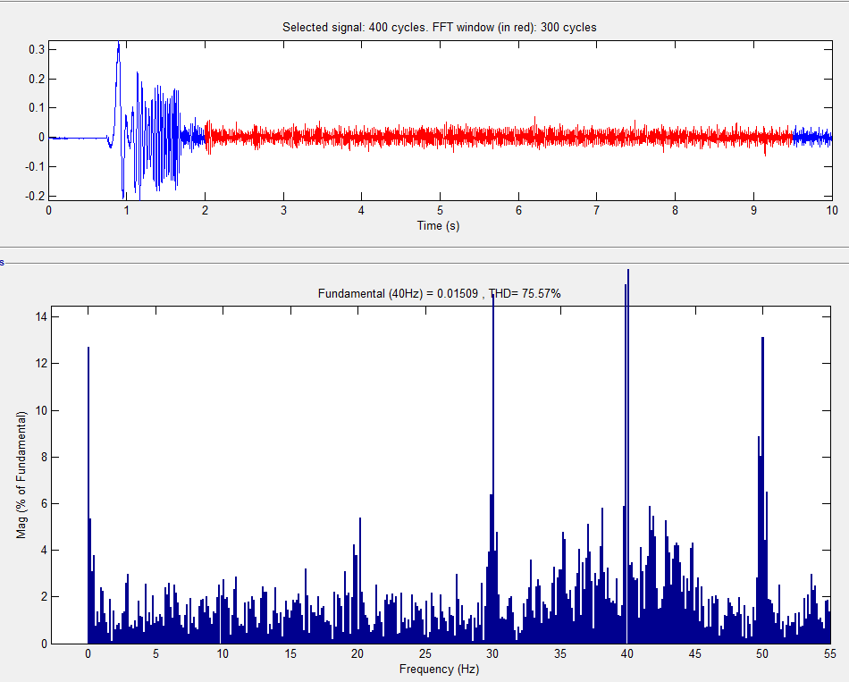
600 rpm no load – 0-55Hz

Slide 14
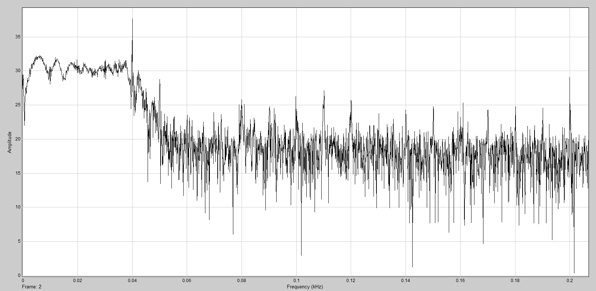
600rpm no load + 2Nm pulse

Slide 15
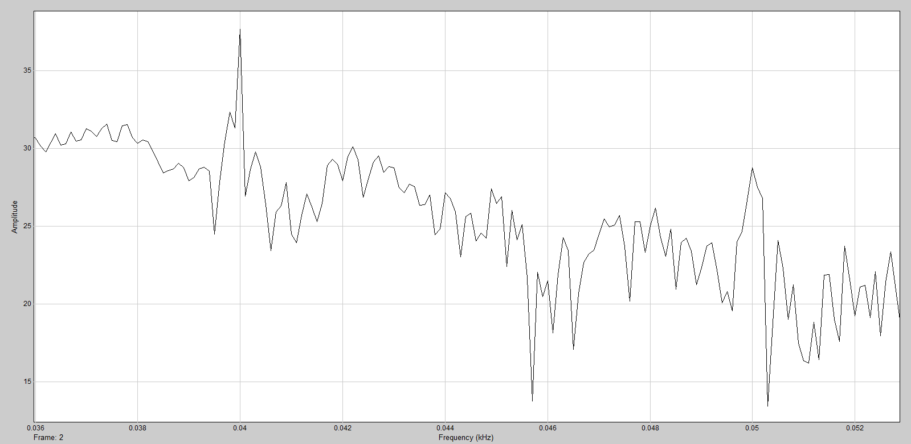
600rpm no load + 2Nm pulse zoom

Slide 16
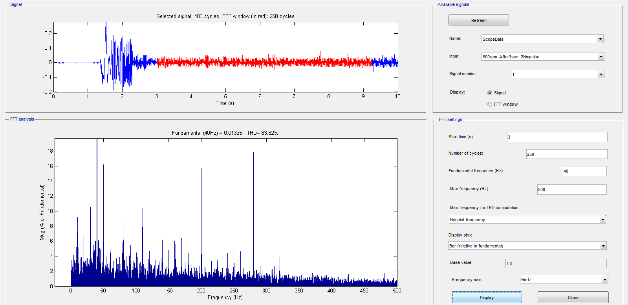
600rpm no load + 2Nm pulse

Slide 17
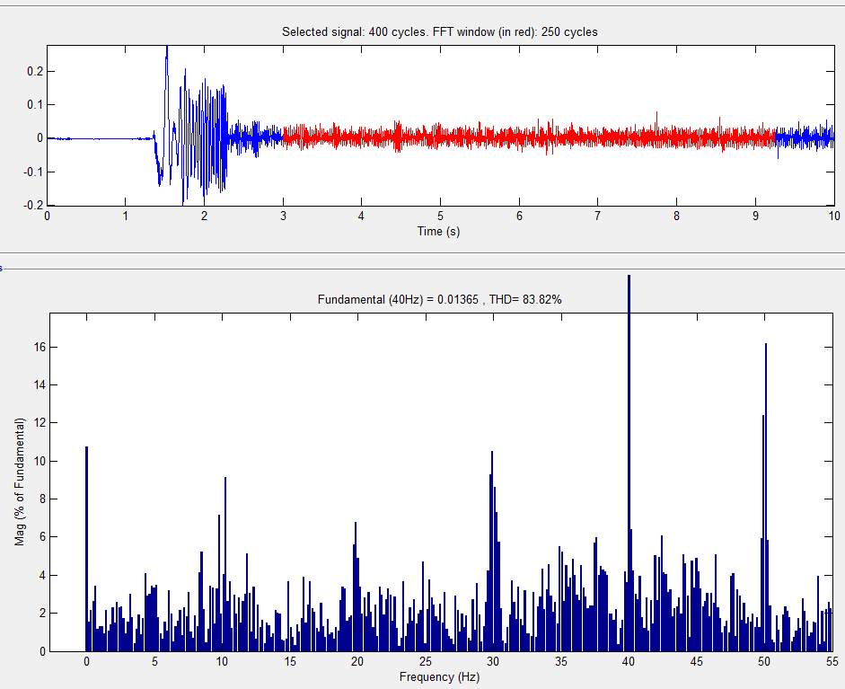
600rpm no load + 2Nm pulse – 0-55Hz

Slide 18
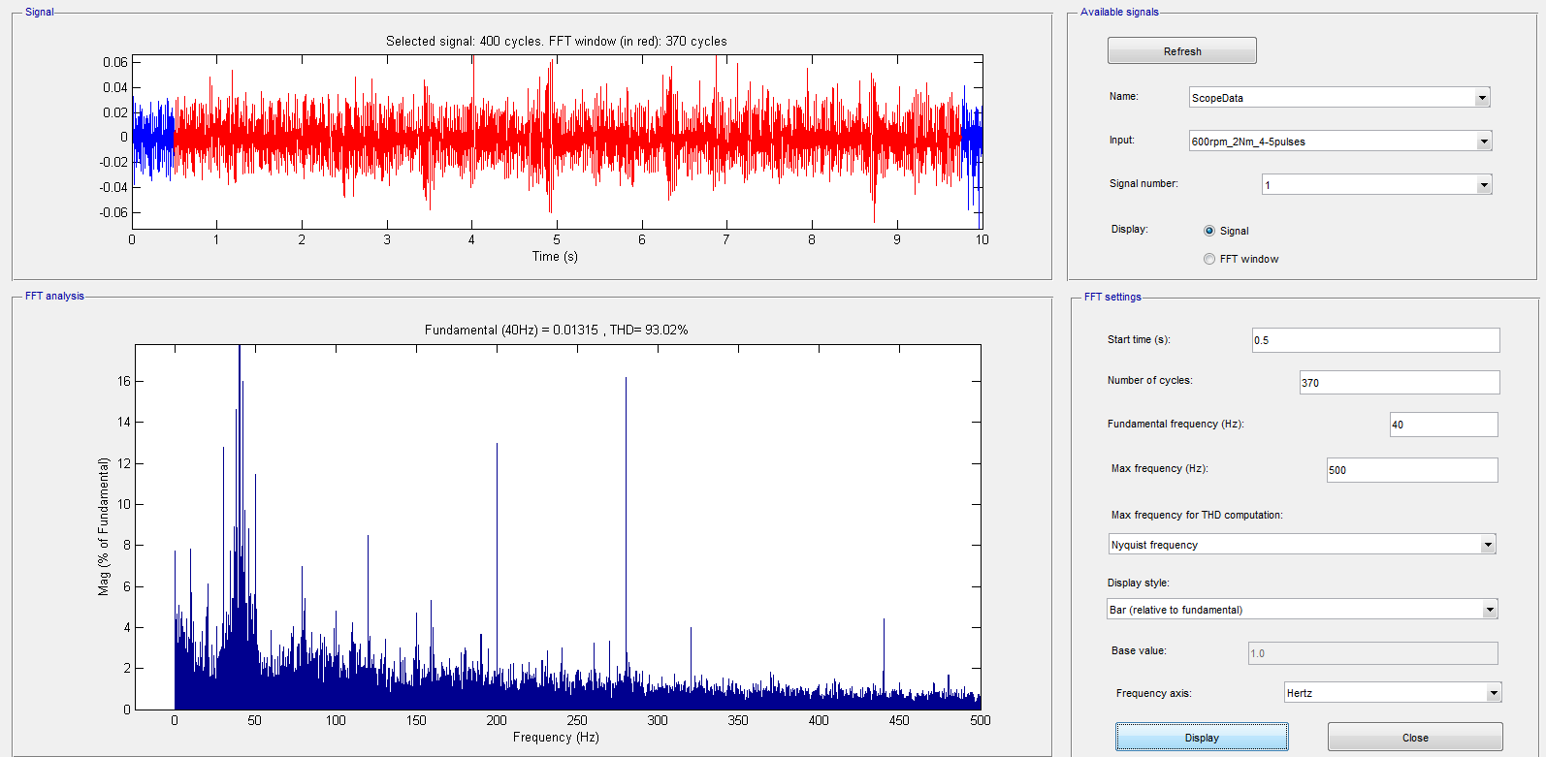
600rpm no load + 4 pieces 2Nm pulse

Slide 19
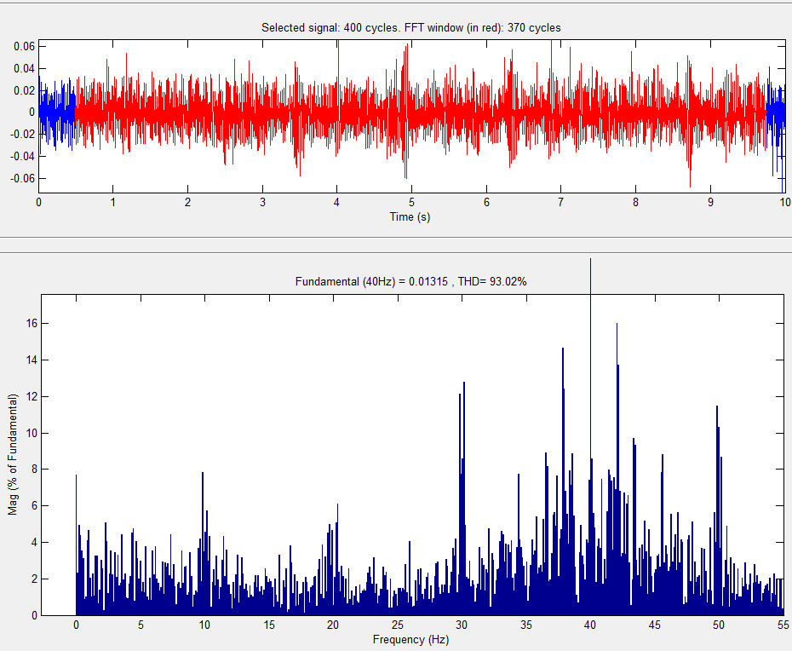
600rpm no load + 4 pieces 2Nm pulse

Slide 20
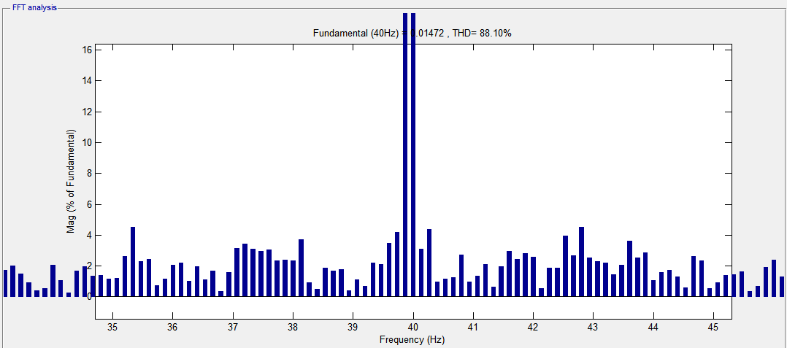
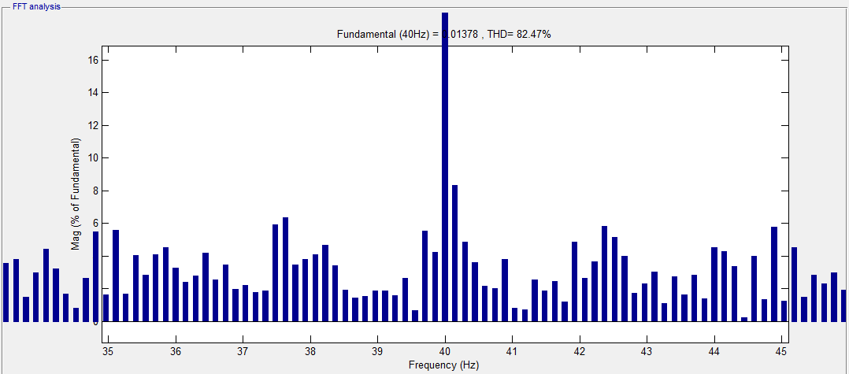
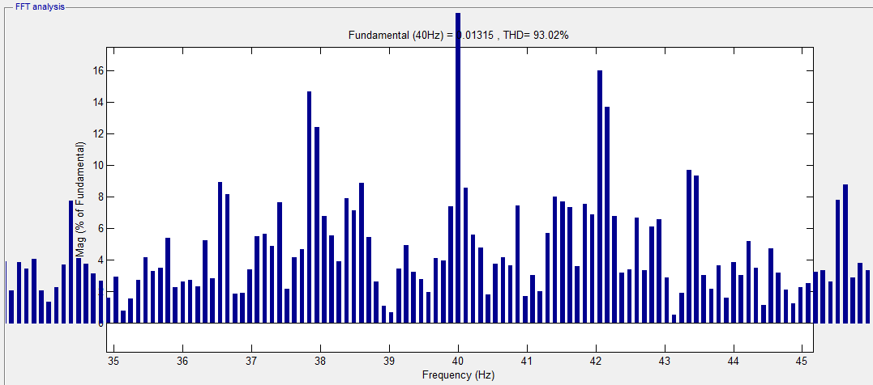
600rpm
No load
600rpm+1piece 2Nm pulse
600rpm+4piece 2Nm pulse

Slide 21
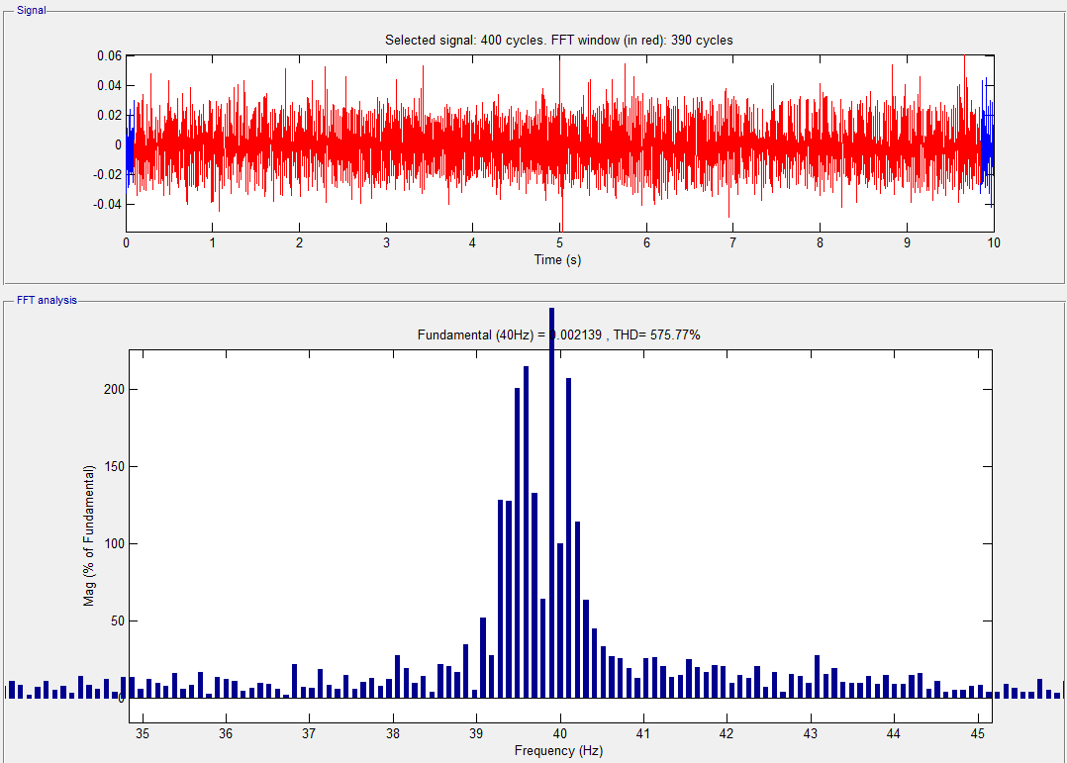
600rpm-590rpm 1sec-600rpm

Slide 22
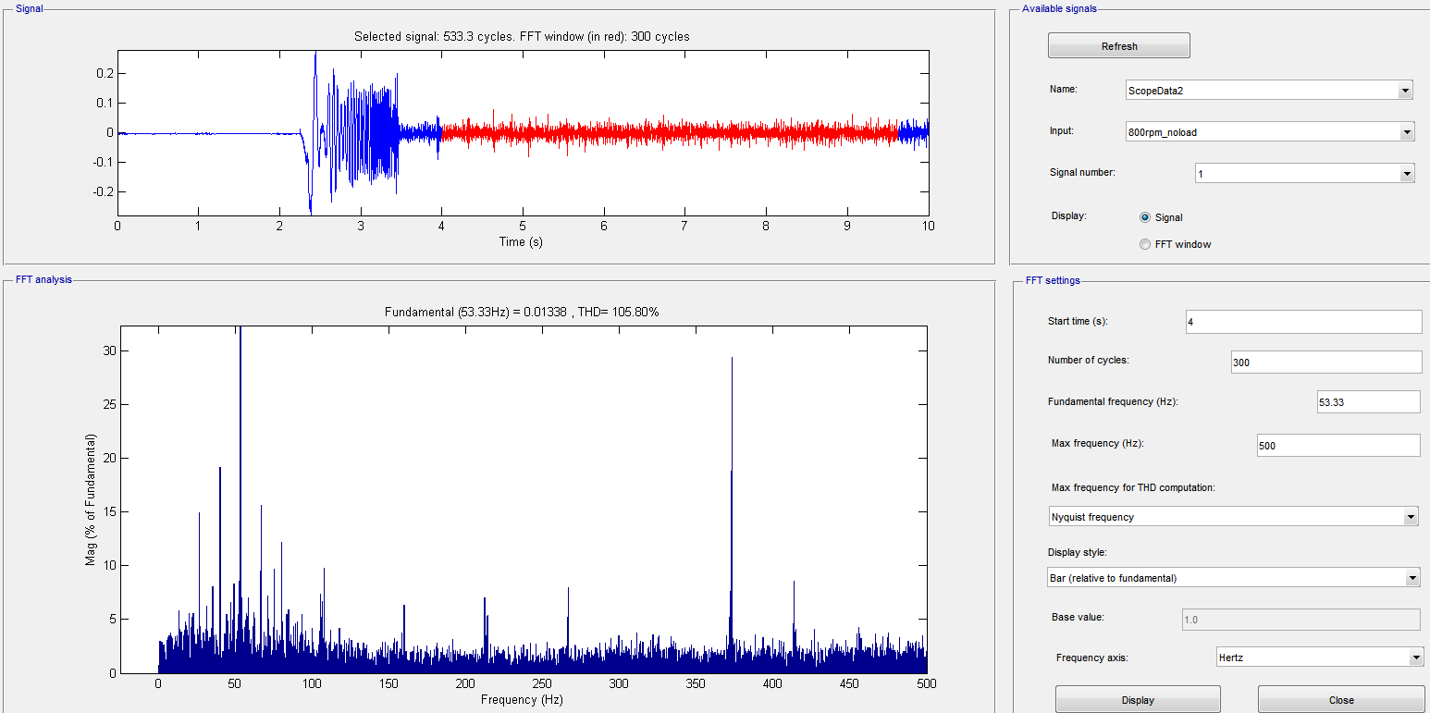
800rpm no load

Slide 23
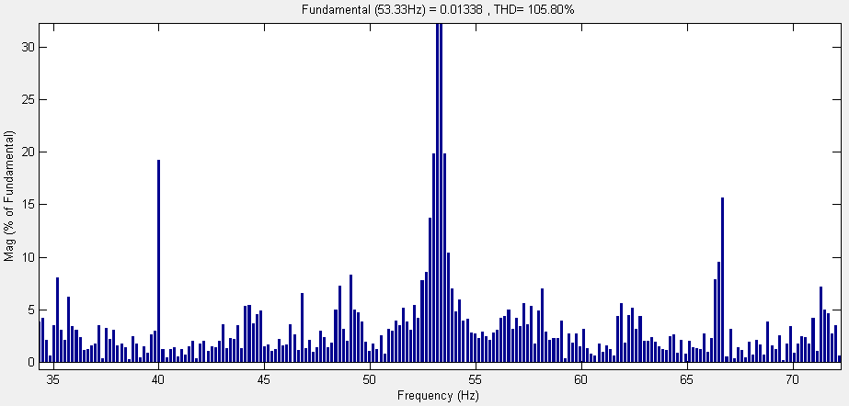
800rpm noload 53.3Hz fund.

Slide 24
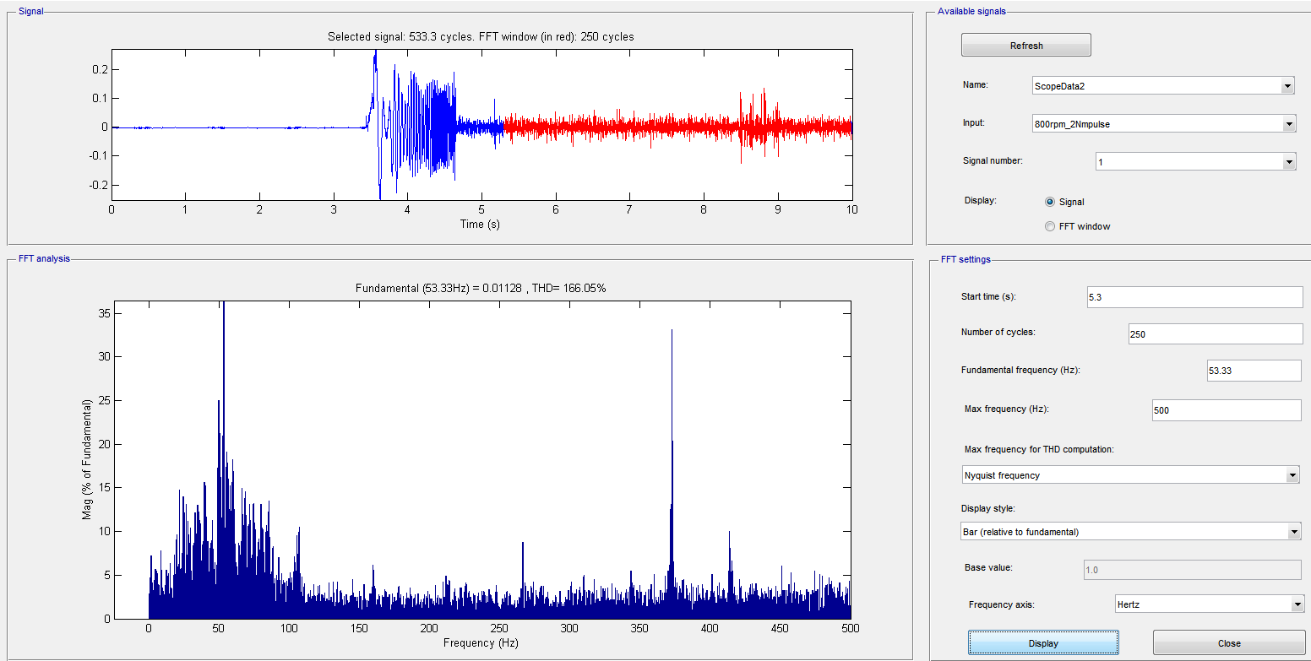
800rpm + 2Nm pulse

Slide 25
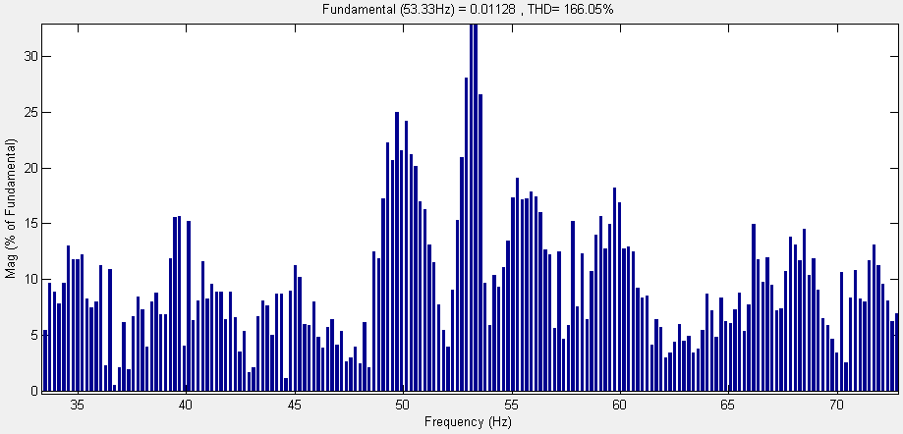
800rpm + 2Nm pulse 53.3Hz

Slide 26
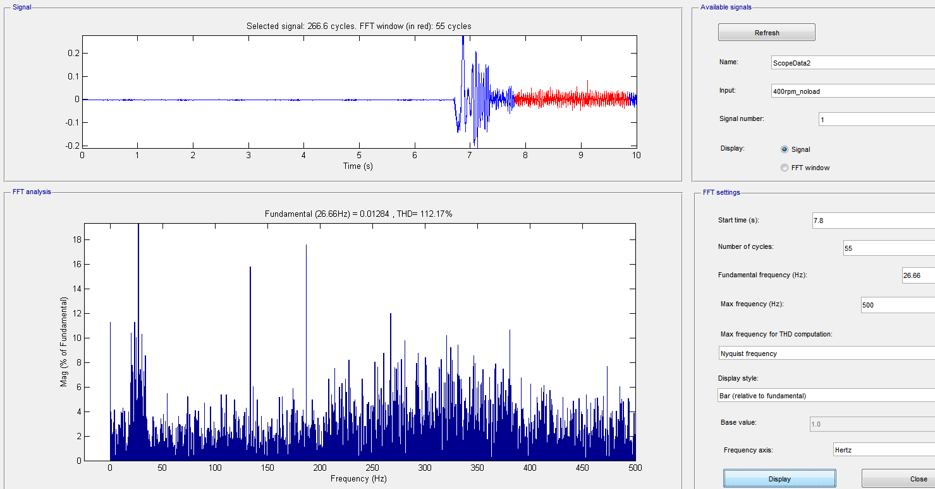
400rpm noload

Slide 27
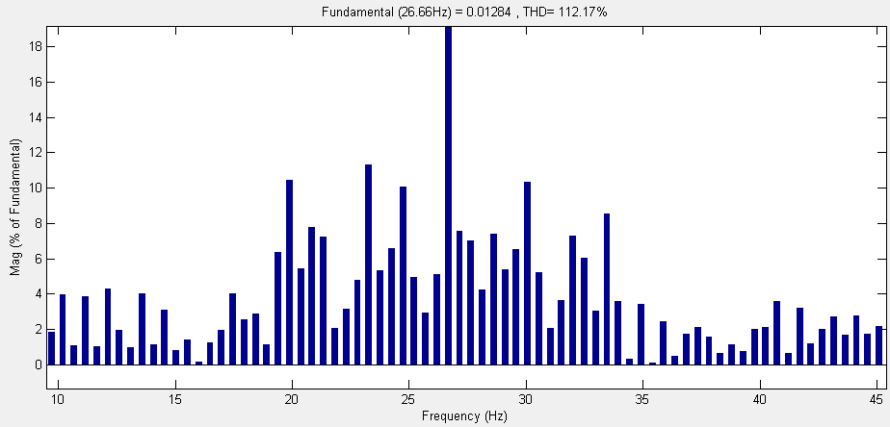
400rpm 26.6Hz fund

Slide 28
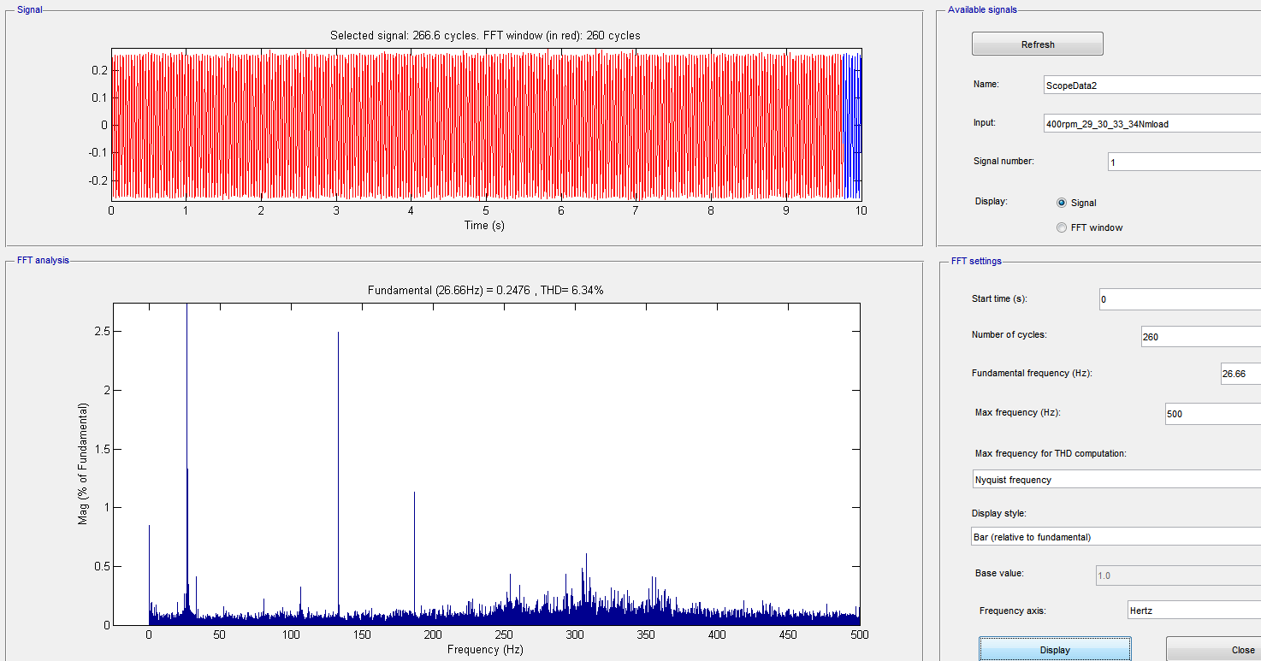
400rpm 29-30-33-34Nm loading

Slide 29
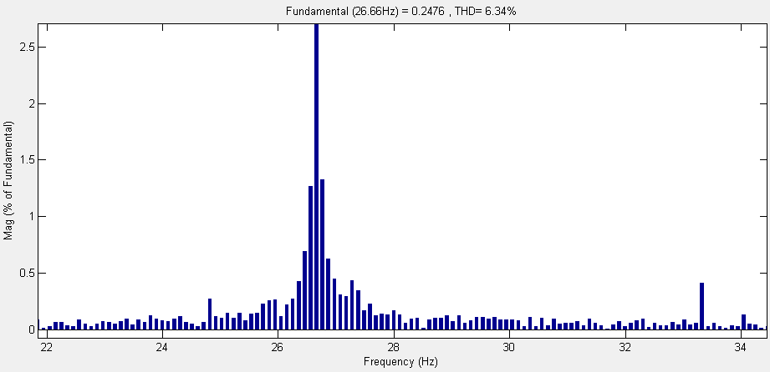
400 rpm 29-30-33-34 Nm loading

Slide 30
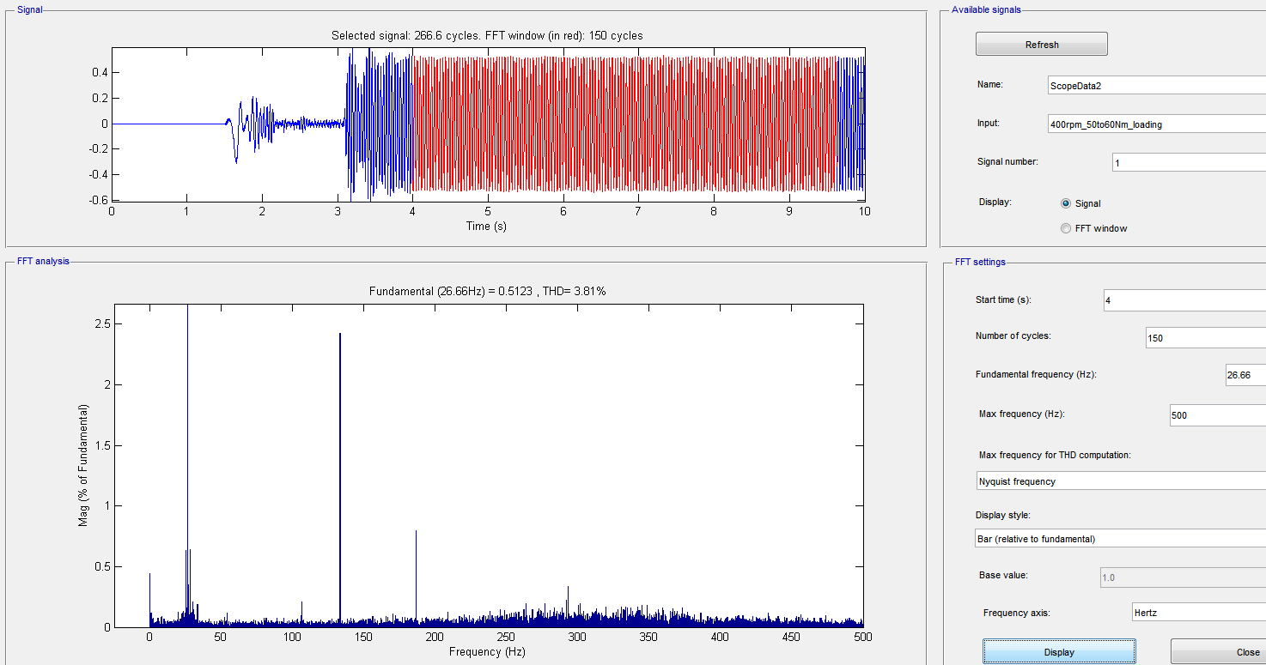
400rpm 60Nm loading

Slide 31
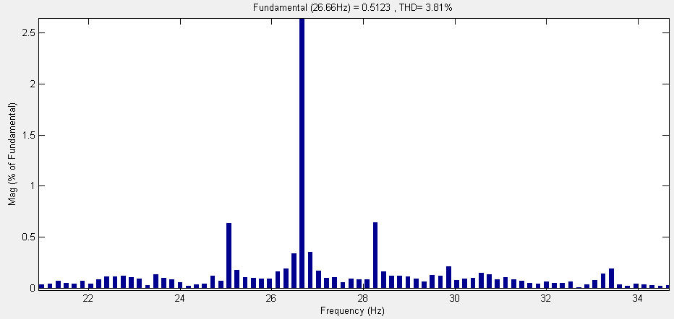
400rpm 60Nm loading

